Slide 1
Sector Report by TPTSEU
2018 August 14-15
UNI Apro MEI Committee Meeting and Forum
Davao City/Philippines

Slide 2
A Transformation or Turbulent era for Audiovisual Media Workers
How to deal with Disruption regulation
How to revamp or re-equip, train the workers

Slide 3
What we gone through those days in 2017-2018
The year-end revision of Labour Act
The second round of Collective agreements is negotiated with Management Staff and Chief Executive Officer
The New Media project is launching under highly consensus between employing institute and employee organization
PTS is complying New Southbound Policy to implement the Southeast Asia news report service and recruiting new staff from professional in there
The revamp public media group is undergoing (including TV, Radio and News Agency)
A minority language service is reorganized by new legislation for Haka people service and Taiwanese service

Slide 4
Several challenges and transformation Union should tackle with care
Facilitate the change caused by revised Labour Act into a factory scheme of protection measure and modifying the version by structured into a media industry thorugh using second round of Collective Bargaining
Highly transparent and affirmative profession position standing on the way for changing broadcasting service caused by a series of timely requests from general election or public opinion in innovating new media and preserving minority language
Ask for a solidarity within workers and employees of public media enterprise and being collectively, jointly processed the reorganizing issues proposed by Ministry of Culture and Management Boards
Emphasizing a group approach adopted by different public media unions into the talks and public consultative process of legislation for public media act
Making a best use of New Southbound policy to collaborated our efforts with the profession group in ASEAN countries

Slide 5
The Major Progress

Slide 6
Labour Standard Act Taiwan’s revised Labour Standards Act passed its third reading in the Legislative Yuan on January 10th, 2018
Replied to the request of progressive Labour movement, the government completed the second revision of Standard Act on 10 Jan. by DPP Government, inciting two impacts on the shop floor,
Stipulated the compensatory leave could be chosen by workers exchanged for the pay causing by the overtime work, however, if not be used after the year-end of expiration, the wages shall be paid based on the day when working hours are extended by employer
Annual paid leaves are arranged by workers principally, however, under the agreement between employers and employee, the leaves could be extend to the end of following year. If the leave is not be used in the end again, the employers must pay for the unused leave nevertheless .

Slide 7
The disruption of regulation is hampering on our second collective bargaining
Background
Based on our aging employees profile, Union proposed to increase the family paid leave from 3 to 5 days
Union proposed a second issue for consideration by providing the incentive of choosing compensatory leave by multiplying 1.5 times of overtime working hours instead of paying by Corporation
Union strategy is achieving benefits with consideration of management cost-saving for exchanging the family paid leave increasing
The above two revised benefits are agreed by both sides
After January, the negotiation is hold by Management talks team
The incentive is decreasing by the revision of Labour Standard Act in paying overtime working hour compulsory in the end of year

Slide 8
The previous Collective Bargaining, but New lesson: good will and trust challenge
The hold dispute is involving between Union, Management Staff, Board of Directors, new elected general manager of news department etc.,
Union started a deep talk between disputed parties due to common background of them as the previous employees of Public Television Service Foundation, including General Manager of News, two Directors in Board
Union adopted the “Willing to talk” and “Number of Fact basis” positioning to extend the communication and debate by respecting the good will of two parties (Management and Union) already carried out practically
The previous practical expertise in running Public Broadcasting Service is handling with care to ease the tension and confrontation against Union and workers’ right issue only

Slide 9
Signed the Second Collective Agreement on July 27 witnessed by Authority, and sister Unions of Public Media

Slide 10
What we learnt from here
develop organising skills and campaigns, gathering the information and study on union organising strategies, and aiming at best practice;

Slide 11
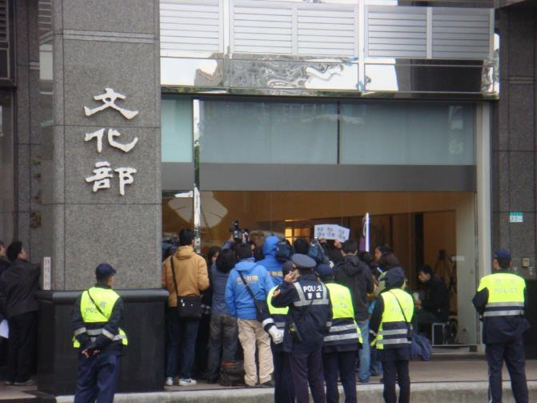
Public Media Act undergoing
Ministry of Culture announced to deploy mega project to revamp public media in 2016
For request the employee directorship, TPTS Union promoted a reform on Public TV Act and related policy issue in a long time
This endeavor earned our entrance to discussing legislation issue on Public media
The TPTS Enterprise Union as the hub of talk for merging
2016
2013

Slide 12
Introduced the conclusion of UNI-MEI GA, 2015 to Public Media Unions locally to gathering solidarity

Slide 13
2017-2018 onward highly presented our Union-approach to the New Legislation

Slide 14
Public Media Employee Unions United, on the Rise
Union-Approach to revising PTS Act recognizable by stakeholders
Worker Participation into
Governance request
Employee Director A Must

Slide 15
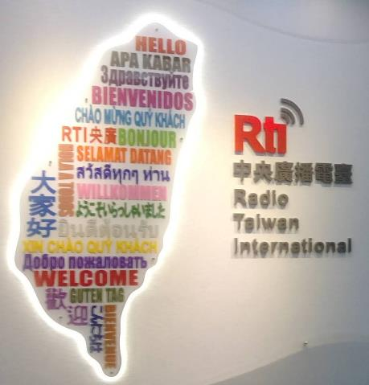
Thanks for Our Sisters and Brothers

Slide 16
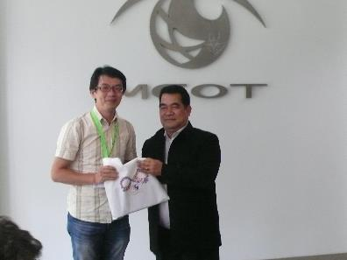
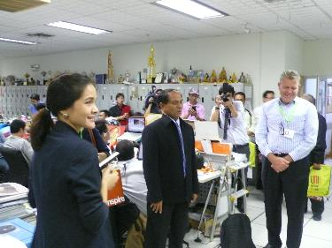
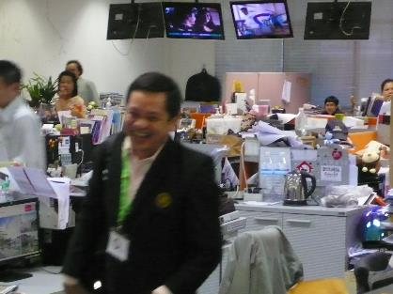
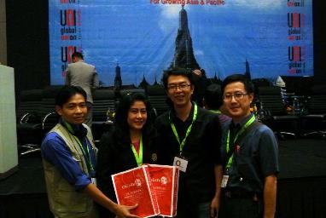
Preserving the Public TV, Radio and National News Agency together by resourcing the cases based on Southbound Policy
Studying the MCOT Media Organization of Thailand from 2013, 2016
Referring the Bernama TV, Malaysia reform from 2015

Slide 17
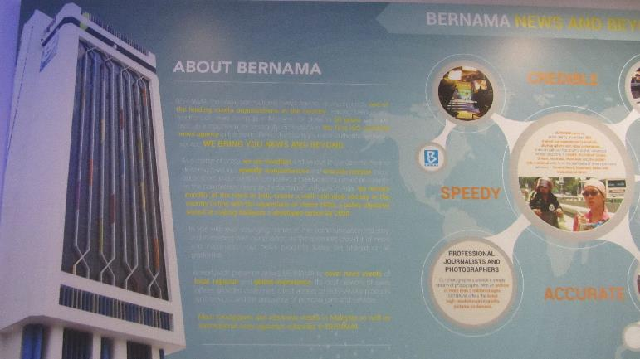
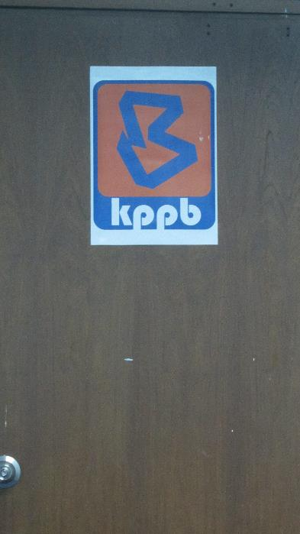
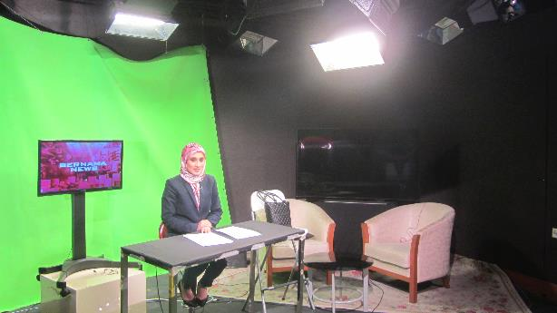
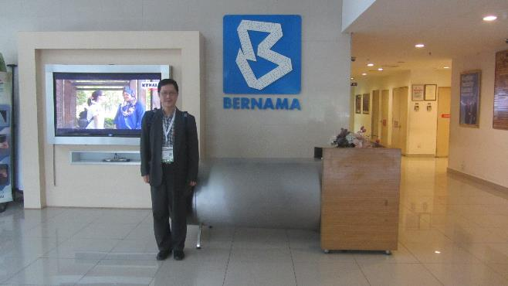
Malaysia, 2017

Slide 18
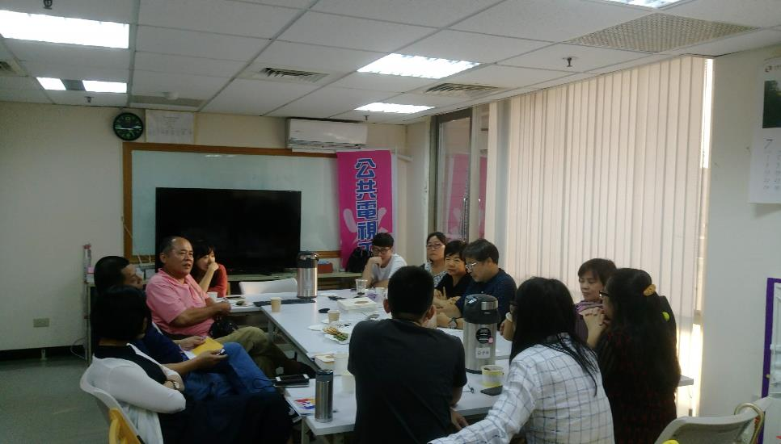
Currently, we reached the consensus with Ministry of Culture
A Employee Directorship is confirmed
The three Enterprise Unions is planned into one Union being Comprehensively representative
The Three Unions are allowed attend the Public Media integration working group
The Sunset Clause will manage the transition into one corporate structure and preserving workforce during this two-year period

Slide 19
What we learnt from here
To develop union alliances targeting local and regional industry associations and to reach agreements on trade union rights and decent work

Slide 20
New Types of Work and Union support
From 2017 to 2018, the outgoing and inward request for a new media service and minor language service within Board of Directors
With the participation of PTS Enterprise Union, the issues are kept transparent and professional based-decision-making

Slide 21
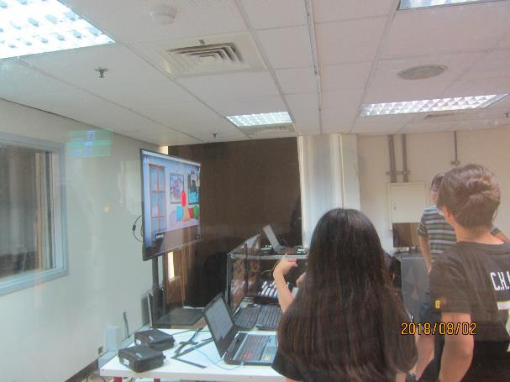
A. Public Service Media Project Centre
With Union President, Shop Steward highly participated into the business (launched in June 2017)
For new establishment, allow flexibly regrouping the permanent workers into one office
Consultative Committee is equipped with the Centre chaired by Directors (public media reform) and ex-professional workers in PTS
Leading by One-Executive Director with Young, Research-oriented and Unionized background (organized social media, streaming platform, project incubator division)
Automation, condensed workflow and peripheral deployed by new media wise thinking

Slide 22
Programm Production
News/
Feature Planning
Social Media
Marketing
R&D
Working group

Slide 23
B. Taiwan PSM News Portal Platform
Reacted to the impending Public Media Act, to integrate the every sector of news production together into one platform and curator
The rollout service by PSM News is a feature form reporting and curating through public algorithm
Based on current documentary and news program, daily news reel, the platform should choose the suitable topics to feature online for netizen.
The planned finance for new PSM news platform is scheduled to deliver annually by USD 330,000 through three-consecutive year.
The 80% of expenditure is spent for human resource and content production

Slide 24
One Editor-in-Chief to work with an young and innovative team
The workforce is mostly consist of permanent staffs from News Desk
The online technician will be outsourcing talent by contract binding
The Union is consulted by Board of Directors on behalf of profession interest to readdress this project into the collaboration with PSM Project Centre
Technical staff
Curation
Planning
Production
Arts Editor
Editor Online
Sessional Assistant

Slide 25
C. The Southeast Asia News Service by PTS
April 2, 2018 PTS launched the Southeast Asia TV News Service in local channel
Aiming at migrant workers from Vietnam, Thailand, and Indonesia
Three-language services by airing 5-minute slot everyday
Hiring ten news translator for production of info-news on daily life concern
Freelance status currently needed to be reviewed by a long-term planning and challenge to be recruited into permanent staff
Source : CNA

Slide 26
D. Taiwanese Dialect and Culture Channel
DPP Government replied to the request of media democratization in preserving minority language
Taiwanese Dialect is used by majority however it is not the official one in Great Chinese Community
Central Government decided to deliver USD 13 million annually to PTS for running a dedicated channel to serving the preservation
PTS and Union requested the amount of Taiwanese Dialect Channel included the finance for permanent workers
Partial amount disburses for the TV production by CTS in order to secure its employment

Slide 27
What we learnt from here
There should also be more extensive government-employer-trade union collaboration and cooperation to develop more effective future workforce strategy to prepare for the disruptive changes and skills requirements. It should include adjustment measures which minimize job displacement and a program to ensure the smooth “transitioning” of the workers from the old to new or reformatted jobs.
Excerpt from the Joint Statement by6th UNI Apro East Asia Affiliates Forum

Slide 28
Future Tasks for Organizing
Erecting a Confederation of Public Media Trade Unions is beginning to be discussed by all stakeholders
Finding a common interest between TPTSEU and TMWU (Taiwan Media Workers’ Union) and showing our solidarity in condition negotiation (for example, exemption to the one fixed rest day in every 7-day period disrupted by a special assignment )
Requesting for an intervention into the real deal behind contract-based workers in TITV denounced by Taiwan Indigenous People Culture Foundation Enterprise Union (partnership with every sector of Taiwan State)
Under the New Southbound Policy promoted by Central Government in every sector, Trade Unions, in which way, handle with this opportunity to enlarge the cooperation with UNI Apro (including Media Unions)

Slide 29
Concluding Remark: Public Media Union under attack, let’s united and being innovative
Source: CTS and TPTSEU, August 8
Source: IPCF Union July 13

